Slide 1
LUC 6
payback analysis

Slide 2
Payback Analysis
_{January 1996}
determines how long it will take for accrued benefits to overtake accrued and continuing costs
most companies want quick payback
3-5 years is typical

Slide 3
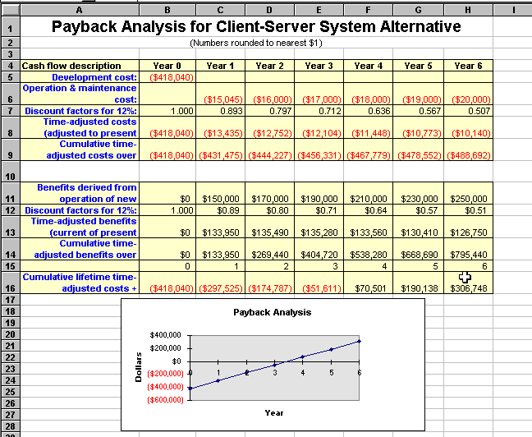

Slide 4
Computing the payback period
Can compute the break-even point:
when does lifetime benefits overtake lifetime costs?
Determine the fraction of a year when payback actually occurs:
| beginning Year amount |
end Year amount + | beginning Year amount |
For our last example, 51,611 / (70,501 + 51,611) = 0.42
Therefore, the payback period is approx 3.4 years

Slide 5
Schedule Feasibility
How long will it take to get the technical expertise?
We may have the technology, but that doesn't mean we have the skills required to properly apply that technology.
May need to hire/ renting new people
Or re-train existing systems staff
Whether hiring or training, it will impact the schedule.
Assess the schedule risk:
Given our technical expertise, are the project deadlines reasonable?
If there are specific deadlines, are they mandatory or desirable?
If the deadlines are not mandatory, the analyst can propose several alternative schedules.

Slide 6
What are the real constraints on project deadlines?
If the project overruns/exceed, what are the consequences?
Deliver a properly functioning information system two months late…
…or deliver an error-prone, useless information system on time?
Missed schedules are bad, but inadequate or insufficient systems are worse!

Slide 7
Operational Feasibility
How do end-users and managers feel about…
…the problem you identified?
…the alternative solutions you are exploring?
You must evaluate:
Not just whether a system can work… but also whether a system will work.
Any solution might meet with resistance:
Does management support the project?
How do the end users feel about their role in the new system?
Which users or managers may resist (or not use) the system?
How will the working environment of the end users change?
Can or will end users and management adapt to the change?

Slide 8
Feasibility Study Contents
Purpose & scope of the study
Objectives (of the study)
who commissioned it & who did it,
sources of information,
process used for the study,
how long did it take,…
Description of present situation
organizational setting, current system(s).
Related factors and constraints.
Problems and requirements
What’s wrong with the present situation?
What changes are needed?
Objectives of the new system.
Goals and relationships between them
Possible alternatives
…including ‘do nothing’.
Criteria for comparison
definition of the criteria
Analysis of alternatives
description of each alternative
evaluation with respect to criteria
cost/benefit analysis and special implications.
Recommendations
what is recommended and implications
what to do next;
E.g. may recommend an interim solution and a permanent solution
Appendices
to include any supporting material.

Slide 9
Comparing Alternatives
How do we compare alternatives?
When there are multiple selection criteria?
When none of the alternatives is superior across the board?
Use a Feasibility Analysis Matrix!
The columns correspond to the candidate solutions;
The rows correspond to the feasibility criteria;
The cells contain the feasibility assessment notes for each candidate;
Each row can be assigned a rank or score for each criterion
e.g., for operational feasibility, candidates can be ranked 1, 2, 3, etc.
A final ranking or score is recorded in the last row.
Other evaluation criteria to include in the matrix
quality of output
ease of use
vendor support
cost of maintenance
load on system

Slide 10
Example matrix

Slide 11
Annual Equivalent Worth (AEW) Analysis
(Also called Equivalent Annual Cost (EAC) or Annual Worth (AW) Analysis)
Annual Equivalent Worth (AEW) converts the net present value (NPV) of a project into an equivalent uniform annual cash flow over its lifespan.
This allows for easier comparison between projects with different durations or cash flow patterns.

Slide 12
Key Concepts
Purpose
Compare projects with different lifespans.
Determine the uniform annual cost or benefit of an investment.
When to Use AEW:
Evaluating mutually exclusive projects with unequal lives.
Assessing recurring costs (e.g., maintenance, leases).
Simplifying complex cash flows into an annualized value.

Slide 13
Formula:
AEW=NPV×( (1+r) n −1 r(1+r) n )
NPV = Net Present Value of the project
r = Discount rate (interest rate)
n = Project lifespan (years)
(The term in brackets is the Capital Recovery Factor (CRF).)
Alternatively, if cash flows are already uniform:
AEW= Annual Cash Flow+Annualized Capital Cost

Slide 14
Steps to Calculate AEW
Compute NPV of the project (as previously discussed).
Apply the Capital Recovery Factor (CRF) to convert NPV into an equivalent annual amount.
Interpret the result:
AEW > 0: The project is economically viable.
AEW < 0: The project is not financially justifiable.

Slide 15
Example Calculation
Scenario:
A machine costs $50,000 upfront.
It generates $15,000/year for 5 years.
The discount rate (r) is 10%.

Slide 16
Step 1: Calculate NPV
NPV= −50,000+ 15,000× 3.7908= −50,000+ 56,862=$6,862
Step 2: Convert NPV to AEW
Using the Capital Recovery Factor (CRF) for n = 5, r = 10%:
CRF= (1+0.10) 5
______________
1 0.10(1+0.10) 5
AEW=6,862×0.2638≈$1,810 per year
​

Slide 17
Interpretation:
The machine provides an equivalent annual profit of $1,810 over 5 years.
If comparing two machines with different lifespans, the higher AEW is better.
AEW vs. NPV
Factor | NPV | AEW
Purpose | Total project value in today's $ | Annualized value over lifespan
Comparison | Best for single projects | Best for comparing unequal lives
Complexity | Direct calculation | Requires NPV first
Use Case | One-time investments | Recurring costs/benefits

Slide 18
Applications
Equipment Replacement Decisions – Compare old vs. new machinery.
Lease vs. Buy Analysis – Determine the annual cost of ownership vs. leasing.
Infrastructure Projects – Compare roads, bridges, or energy projects with different lifespans.

Slide 19
Limitations
Assumes cash flows are repeatable (may not apply to unique projects).
Sensitive to discount rate and lifespan assumptions.

